Slide 1

Hi, I’m Aris siamos
Bachelor degree in electrical engineering
Currently working as full stack developer (Laravel, custom frontend)
Love to learn new things and get new experiences

Slide 2
What they gave us!
Sacchon is a diabetes management Rest API developed in restlet framework.
Rest API consists of three major components: Repository of Medical Data,
The Doctor Advice Service System, and the Reporting Service.

Slide 3
What problems we faced
Structure design needed to be fixed
Bad name usage, uncleared definitions.
Big methods
Router too confusing and too big
Needed validation and better authorization check
Jwt authentication was missing
Design patterns

Slide 4
How we solved the problems
Create some basic Service and Interface folders
Create a layered infrastructure controller-service-repository
Add constructor dependency injection
Reduce method’s size by creating new smaller and more specific methods
Better naming on variables and methods more accurate on what they’re doing
Create dto classes for better communication between the services
Better organized the router system
Create validation on controllers
Fix some authorization issues

Slide 5
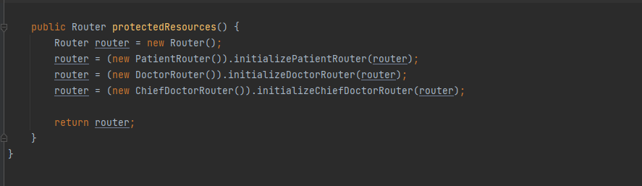

Slide 6
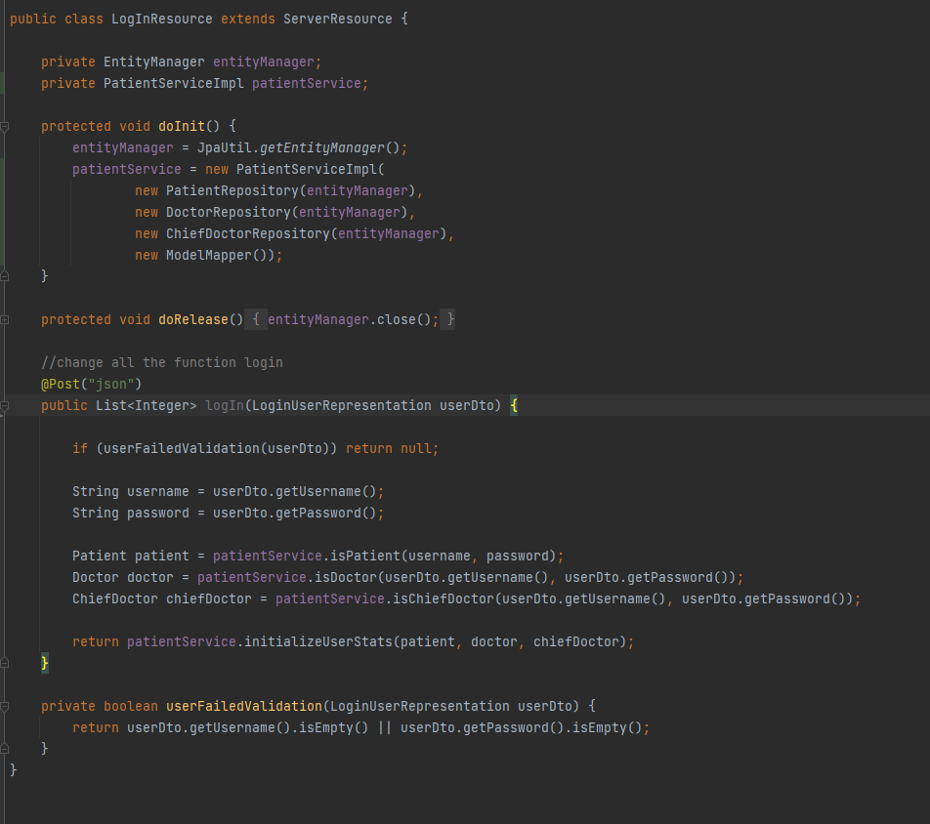

Slide 7
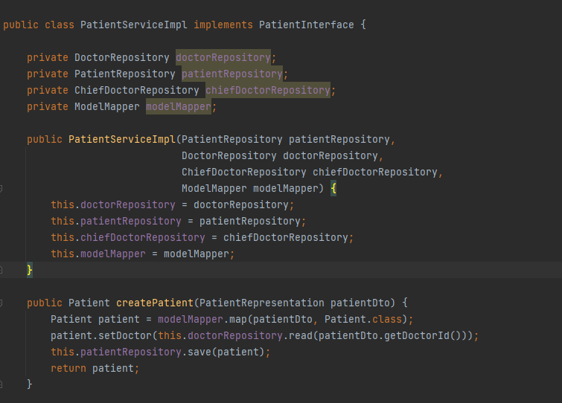

Slide 8
What else needs to be done
The code needs more method refactor
Usage of design patterns
A response class that returns json data with status (301, 404, 200 etc)
Better layered validation
Better authorization check
JWT authentication
Database schema refactor (some tables can be merge)
Router refactor (a lot of routes can be cut out)
Controllers refactor and merge methods
Create Unit Tests for all the methods
Etc..

Slide 9

Any questions?

